Slide 1
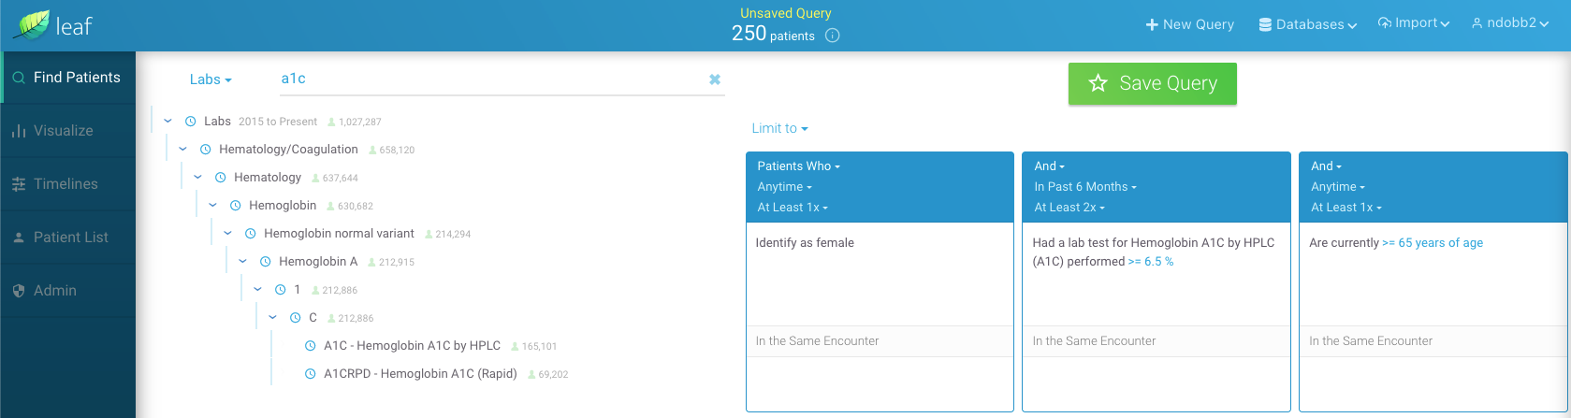
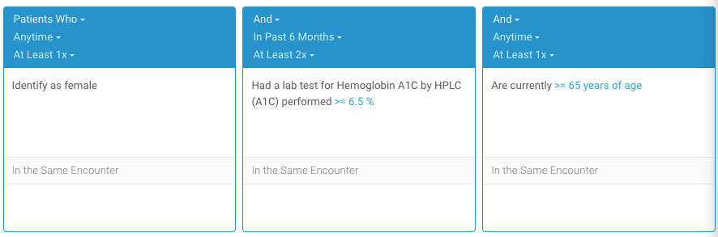

Slide 2
intersect(
cond(“Diabetic”),
union(
female(),
male()
),
age()
.num_filter(
eq(op(GT), val(“65”))
),
neg(
contraindication(
drug(“metformin”)
)
)
)
“Diabetic women and men aged over 65 with no contraindications to metformin”

Slide 3
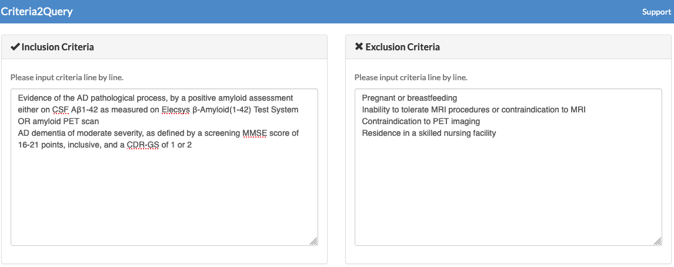
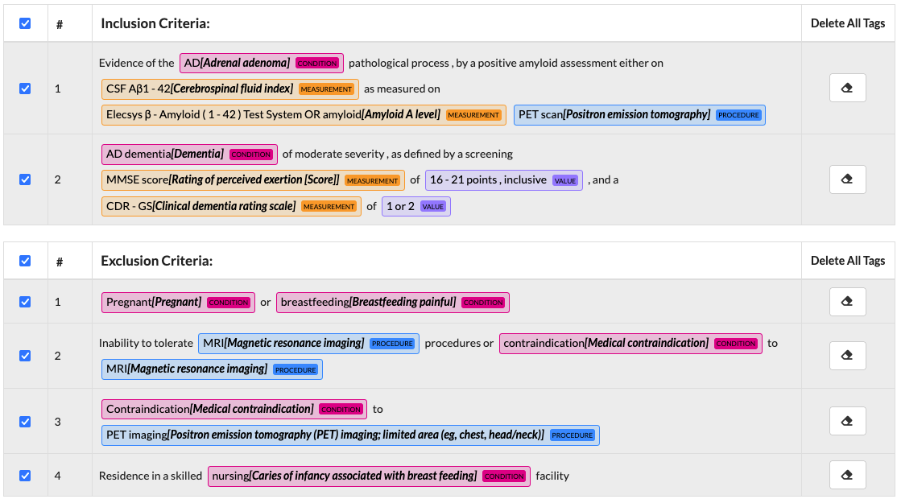

Slide 4
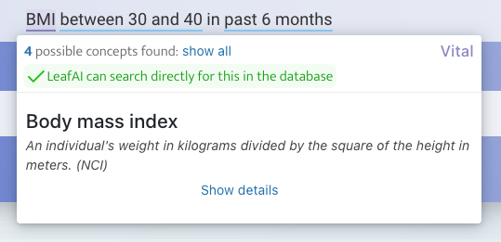
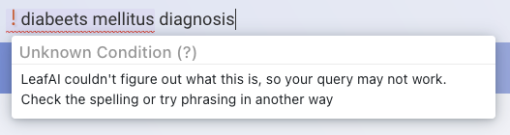


Slide 5
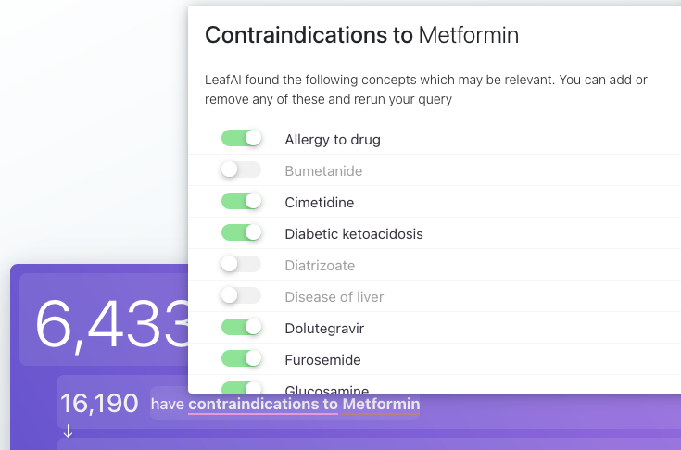

Slide 6
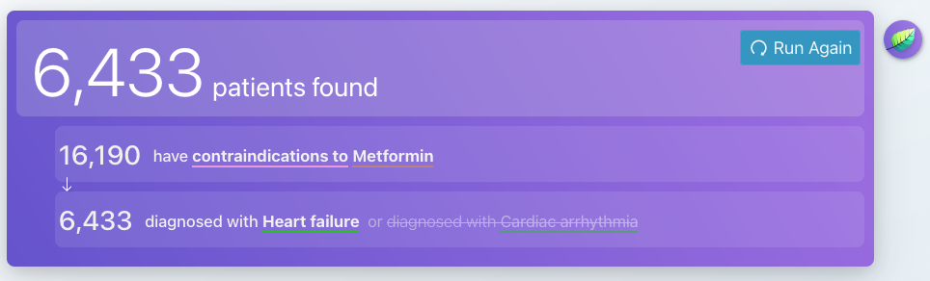

Slide 7

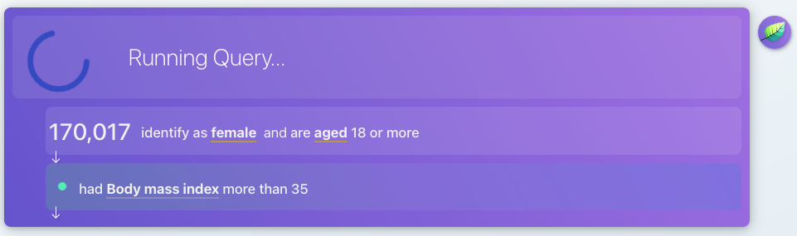
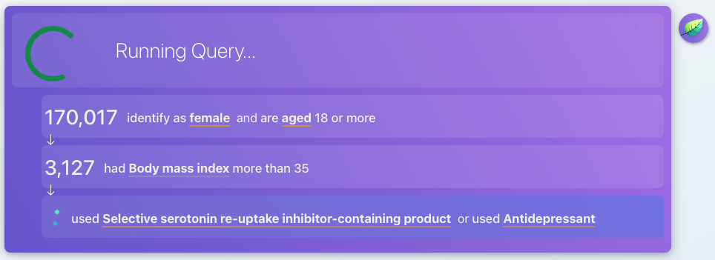
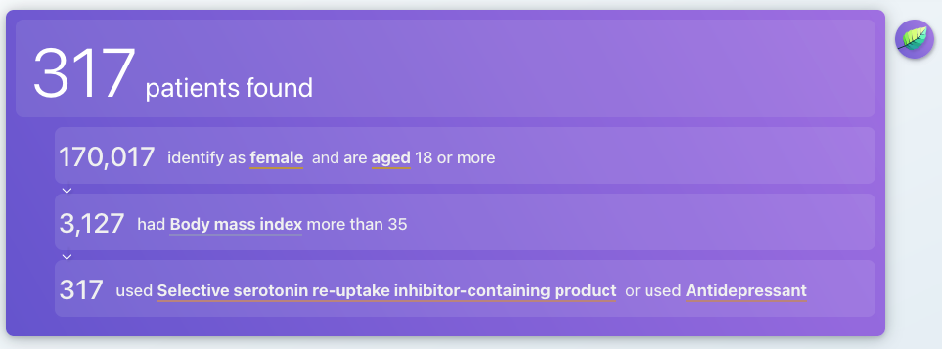

Slide 9

Semantic Metadata Mapping
Knowledge Base
Clinical Database
RDF + SPARQL
SQL Compiler
LOINC2HPO
SELECT person_id
FROM person
WHERE ...
9
C#
Disease Ontology
C#
Symptom Ontology
10
UMLS
Named Entity Recognition
8
Potential Drug-Drug Interactions (PDDI)
BERT
COVID-19 Ontology
Eligibility Criteria
2
Python
Women and men over age 65
Diagnosed with heart failure in past 6 months
1
Relation Extraction
Reasoner
Rules
R-BERT
7
3
C#
Python
Logical Form Transformation
Logical Form Interpreter
Normalization
MetaMapLite
BERT (Labs)
T5
Rec. Descent Parser
6
4
5
Java
Python
Python
C#

Slide 10
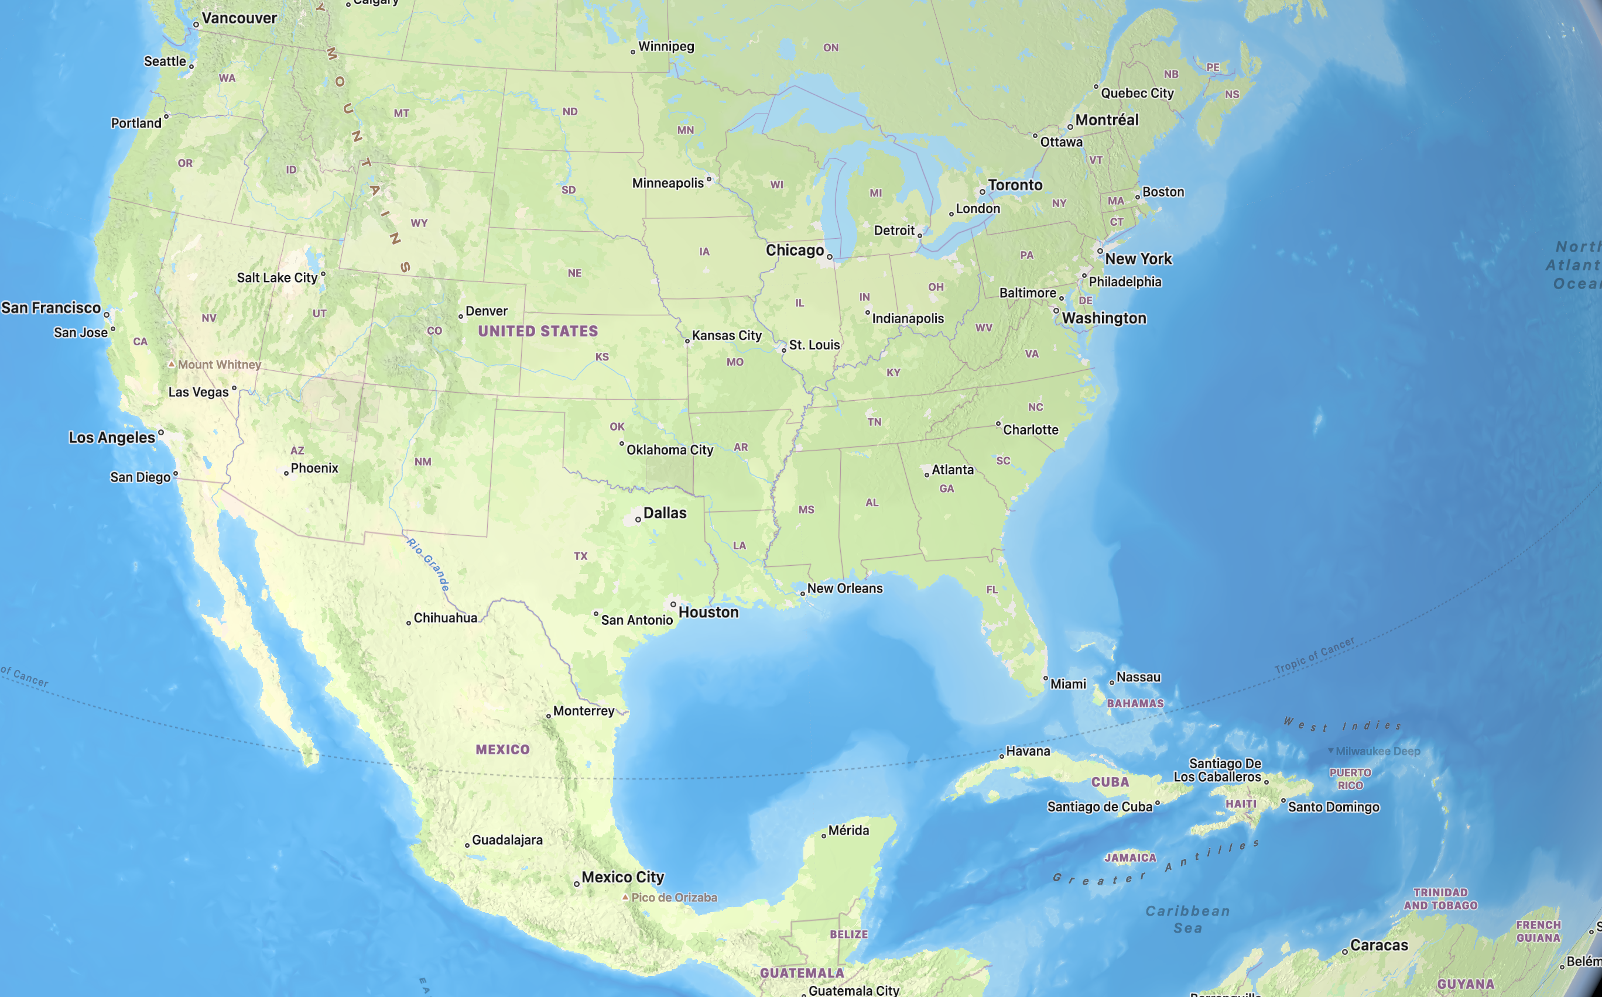
Production
Testing
Academic Med. Center
Commercial Org.
Not Shown
U. of Dundee (Scotland)
U. of Sydney (Aus.)
Melbourne Childrens (Aus.)
Sun Yat-Sen U. (China)
BIOMERIS (Italy)
DXC (UK)

Slide 11
